Slide 1
OT Unit
in
Center 21
Hadeel Hussain
Fatma Alhasawi

Slide 2
Setting..
A vocational rehabilitation clinic
Will be apart of Centre 21
Address: Hawally
Target Population
21+ patients of Centre 21 with different mental dysfunctions
(ADHD, ADD, Autism)
In the future, larger population will be targeted (From outside the clinic)

Slide 3
Manpower Four OTs, One Social Worker and One Receptionist
Job Description: (Working hours 10-6)
Each Occupational therapist will take 5 clients for 4 days. The therapist will have 1 day for visiting workplaces to:
Assess workplace
Plan for modifications
Advocate
Apply environmental modifications
Train patients in real contexts (Place and Train )

Slide 4
Manpower
The Social Worker role is to manage processes of workplace:
Advocate for finding job opportunities for patients
Manage problems rising in the workplace
Assuring the continuation of patient support in workplace
Frequently check the safety measures
Assuring that workplaces are committed to the deals

Slide 5
Place Description
Office Room
Interviews
Intervention Rooms
A room contains a Library, A preparatory kitchen and office corner
A room for Group Therapy
Staff Room
Storage Room
Bathroom (1/males, 1/females)
Garden (Multipurpose)
OT Clinic

Slide 6
Map
of
The
Setting

Slide 7
Computers
Photocopier
Table
Library
White Board
Table
Kitchen
← Entrance
Door to Garden →
Receptionist
Cabinet
Cabinet
Bathroom
Sofa
Desk
Sofa
Desk
Desk
Cabinet
Sofa
Cabinet
Desk
Desk
Desk
Cabinet

Slide 8
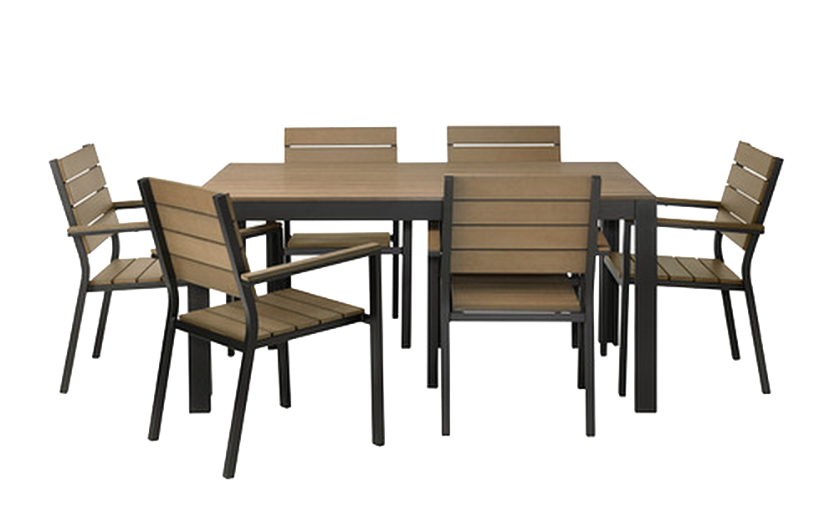
Entrance Door to Garden

Slide 9
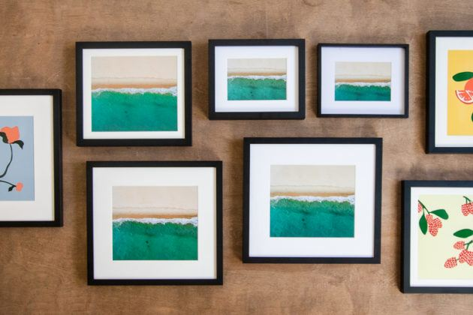
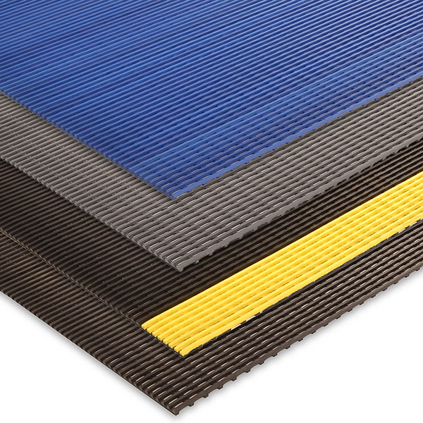
Furniture
Tables with Chairs
Sofa
Storage Cabinets
For Books and Tools
Safety Floor Mats
To prevent slip and fall accidents
White Board
Desks
Wall Frames
Safety illustrations
Task steps illustrations

Slide 10
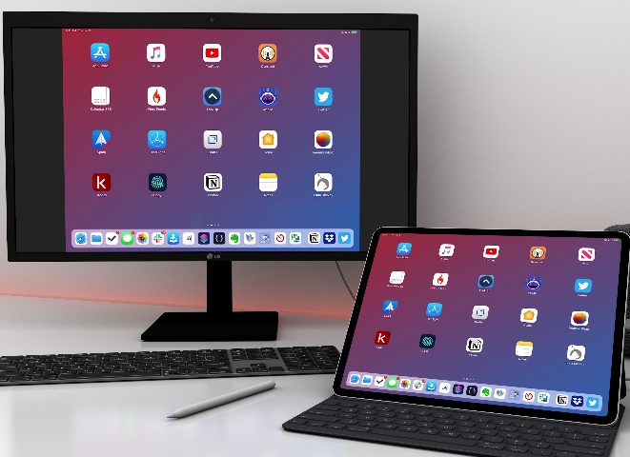
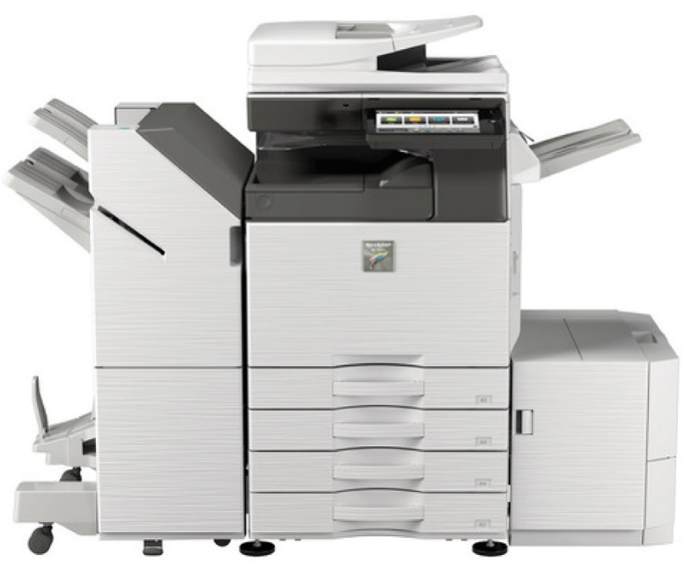
Electronics
Computers
iPads (Apps)
Virtual Reality (VR)
Camera
Alarms
Photocopier
Lightning system
Electric oven and stove
Fridge
Heater
Water Coolers
Microwave
Coffee Maker

Slide 11
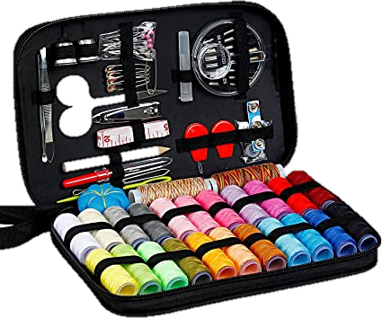
Tools
Assessment Tools
WEIS → To assess all aspects of work environment
WRI → To assess OP, satisfaction, SR, QOL
Books
Stationery
Gardening Tools / Plants & Trees
Sewing Kit
T-shirts & Paintings
Hand Sanitizer

Slide 12
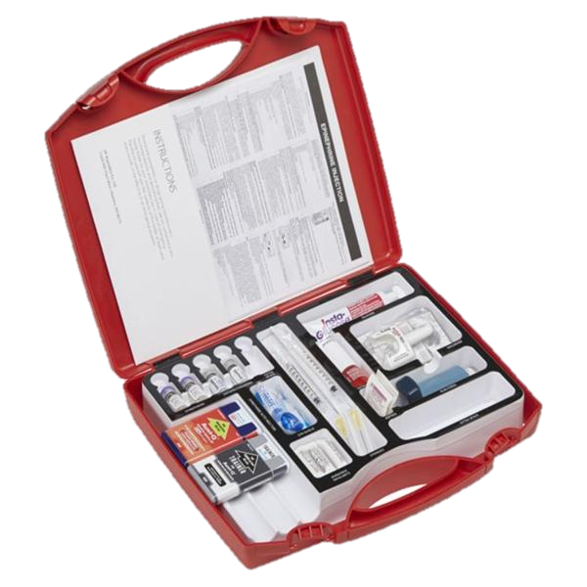
Tools
Cognitive kit:
Puzzles
Memory cards
Riddles
Artificial money
Cards
Chess
Domino’s
Sequencing games
Groceries
Emergency kit

Slide 13
Activities to Improve Skills
Communication Skills
Following
Steps
Problem Solving Skills
Ex. Group training
Treasure Hunter
Cognitive activities
Ex. Activities with multiple steps
Ex. Drill Training
Lost materials
Fire drill
Lockdown drill

Slide 14
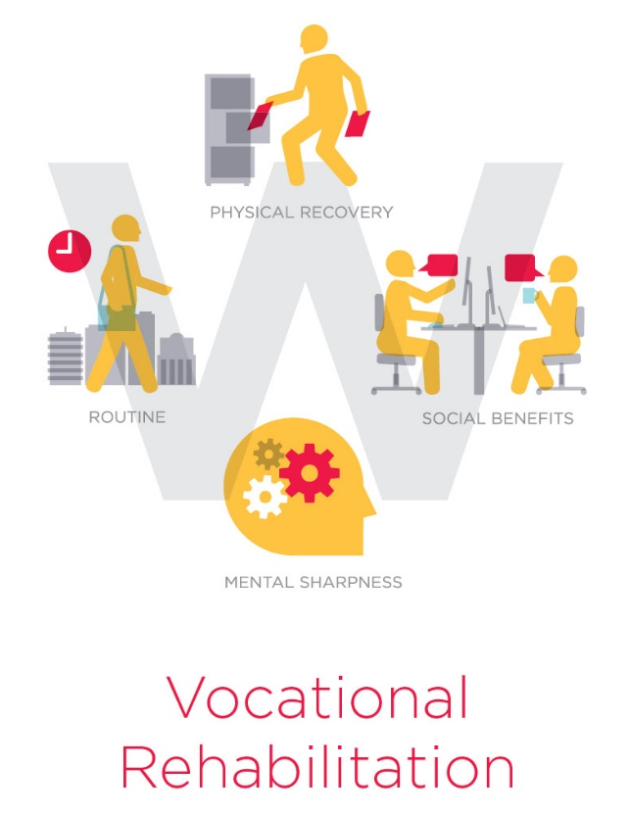
Services
Training on: (Simulatory)
Working in a restaurant / Cafe’
Cashier
Waiter
Coffee Maker
Supermarket (Shop Assistant)
Copy Center (Photocopying)
Library (Librarian Assistant)
Office Work
Photography
Gardening
Tailoring
Clothes designing

Slide 15
Reason of The Project
A Large percentage of adults with mental health problems have no jobs or aims to achieve
Work can:
Improve the quality of life and wellbeing
Give structure and routine to their day-to-day life
Give purpose and meaning to their life.
Promote opportunities for social inclusion and support
Provide financial security
In Kuwait, KCMH is the only center that offers the service of vocational rehab and not all people are able to benefit from it due to the increased pressure on the center and the large number of patients on waiting lists

Slide 16
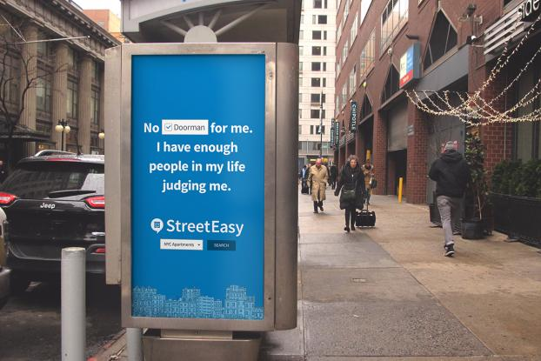
Ways to Attract Clients!
Social Media
TV Ads
Street Ads (signs)
Brochures
Magazines and Newspaper
Small booths in different public areas (malls, supermarket)

Slide 17
Total Cost
=
508,900

Slide 18
Limited Budget?!
Remove all electronics (computers and iPads)
We would use the kitchen and the library that are already in the center
The center already arranges trips so we could take them to certain places and let them experience working there after taking permission
Reduce the number of therapists

Slide 19
Thank You

Slide 20
References
Lloyd, C. (2003). Vocational Rehabilitation and Mental Health (1st ed.). Oxford, united kingdom: Wiley.
Sohn, B.K., Hwang, J.Y, Park, S.M, Choi, J.S., Lee, J.M., Lee, J.Y., Jung, H.Y. (2016). Developing a Virtual Reality-Based Vocational Rehabilitation Training Program for Patients with Schizophrenia. RAPID COMMUNICATION. 19 (11): 686-691

